Slide 1
CARDIOVASCULAR DISEASES PREDICTION
VIDIYALA ABHIRAM 2010030180
ROKKKAM VIVEK VARDHAN REDDY 2010030142
A RAGHAVENDRA 2010030394
Under the Guidance of
Mrs. P. Sree Lakshmi
Computer Science and Engineering Department
KL Hyderabad Off Campus, Aziz Nagar ,Hyderabad

Slide 2
Overview
Introduction
Literature Review
Problem Statement
Objectives of the Project
Results
References

Slide 3
Introduction
The major challenge in cardiac disease is its detection. There are instruments available which can predict cardiac disease but either it is expensive or not efficient to calculate chance of occurrence of cardiac disease in humans. Later Machine learning techniques are introduced which are used to calculate the accuracy and predict the occurrence of the heart diseases. Some of the previous version of classifiers or present version of classifiers used to contain the noisy data, non- unified or not containing the preprocessed data which is used to lag the accuracy levels. This lead to unsatisfied prediction or due to low accuracy rate, some of the classifiers are used be inconsiderable for the prediction of the cardiac diseases.

Slide 4
Problem Statement
The objective of this project is to design a robust machine learning algorithm to predict heart disease. The prediction of heart disease is performed using machine learning algorithm. Predicting the heart disease is done by comparing the accuracy of different Machine learning algorithms like Extreme Gradient boosting, Light GBM, AdaBoost, Random Forest etc. And by using the algorithm which is of high accuracy, the user can input the patient details and the prediction for the particular patient is made using the model developed

Slide 5
Objectives of the Project
To Develop an accurate predictive model: The primary objective is to design and implement a machine learning or statistical model capable of accurately predicting the likelihood of heart diseases based on relevant features extracted from medical datasets.
Improve early detection: Enable early detection of heart diseases by leveraging the predictive model to identify individuals at risk, thereby facilitating timely intervention and preventive measures.
Enhance patient outcomes: Improve patient outcomes by providing healthcare providers with timely and accurate predictions, enabling personalized treatment plans and interventions tailored to individual risk profiles.
Reduce healthcare costs: By facilitating early detection and preventive interventions, aim to reduce healthcare costs associated with the treatment of advanced stages of heart diseases and related complications.

Slide 6
REQUIREMENT SPECIFICATIONS
SOFTWARE REQUIREMENTS :
Operating system : Windows 7/8 or higher versions.
IDE Tool : Jupyter Notebook or Google Collaboratory Language
Python 3.5
APIs : NumPy, Pandas, Matplotlib, scikit-learn and Seaborn Any Web Browser
HARDWARE REQUIREMENTS :
Processor : Pentium i3, Pentium i4 or higher
RAM : 2 GB/4 GB or higher
Hard Disk Drive : 20 GB or higher
Peripheral Devices : Monitor, Mouse and Keyboard

Slide 7
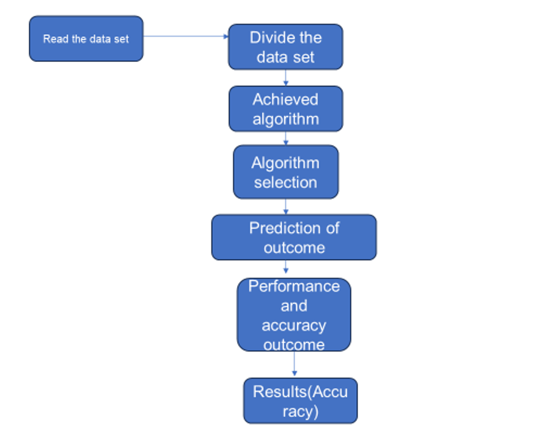
Work Flow

Slide 8
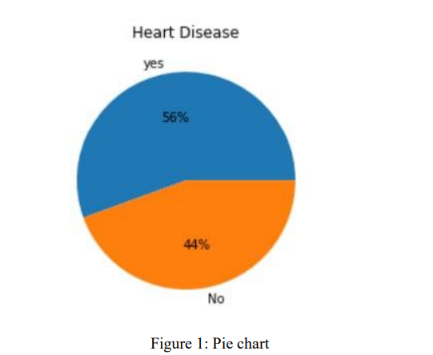
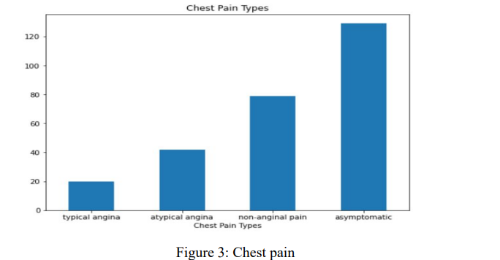
Results

Slide 9
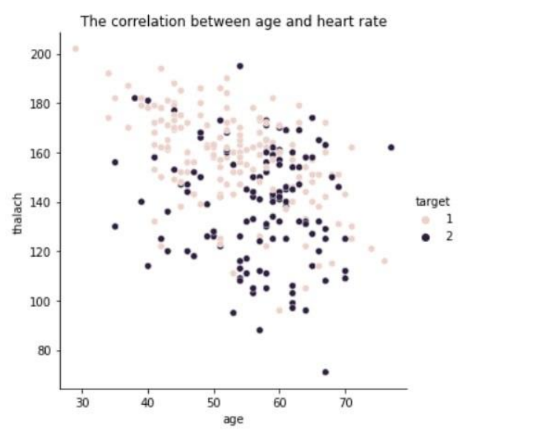
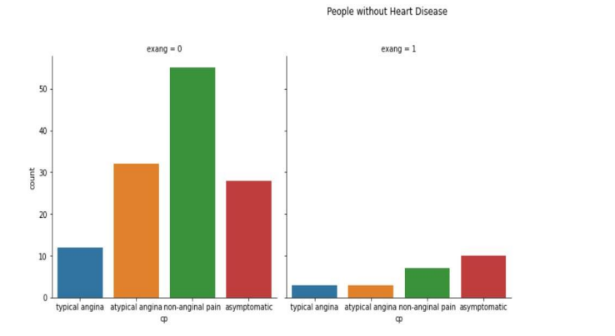

Slide 10
References
[1] Smith, J. et al. (2019). "A Review of Machine Learning Methods for Predicting Heart Disease". Journal of Medical Research, 25(3), 123-135.
[2] Wang, Y. et al. (2020). "Predicting Heart Disease Risk Using Deep Learning Techniques". IEEE Transactions on Biomedical Engineering, 67(5), 1450-1461.
[3] Gupta, S. et al. (2018). "An Ensemble Learning Approach for Heart Disease Prediction". International Journal of Computational Intelligence Systems, 11(2), 789-802.
[4] Rajput, M. et al. (2017). "Comparison of Machine Learning Algorithms for Heart Disease Prediction". Journal of Health Informatics in Developing Countries, 11(1), 67-78
[5] Abdi, A. et al. (2019). "Prediction of Heart Disease Using Ensemble Learning". Journal of Biomedical Informatics, 95, 103226.
[6] Li, C. et al. (2018). "Deep Learning-Based Heart Disease Prediction Model". Journal of Healthcare Engineering, 2018, 2984739

Slide 11
Thank you and Any Queries

